Slide 1

INNOVATION AND Self DRIVING CARS

Slide 2


Slide 3
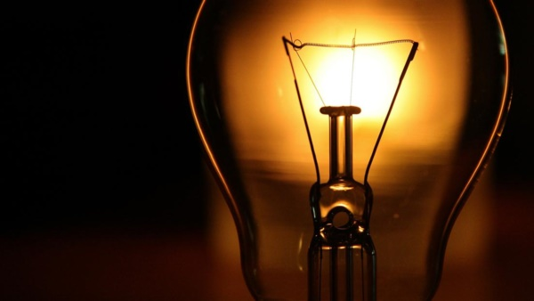
Light Bulb
Thomas Edison invented Light Bulb in year 1879.

Slide 4
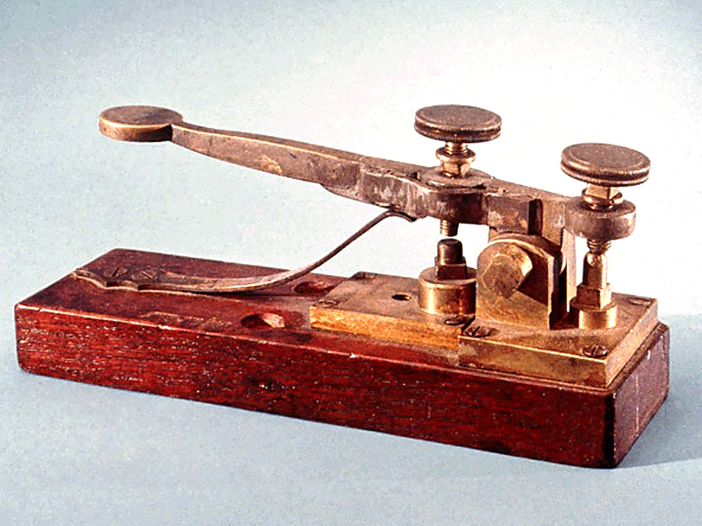
TELEGRAPH
The telegraph used Samuel Morse’s famous Morse code to convey messages by intermittently stopping the flow of electricity along communications wires.

Slide 5
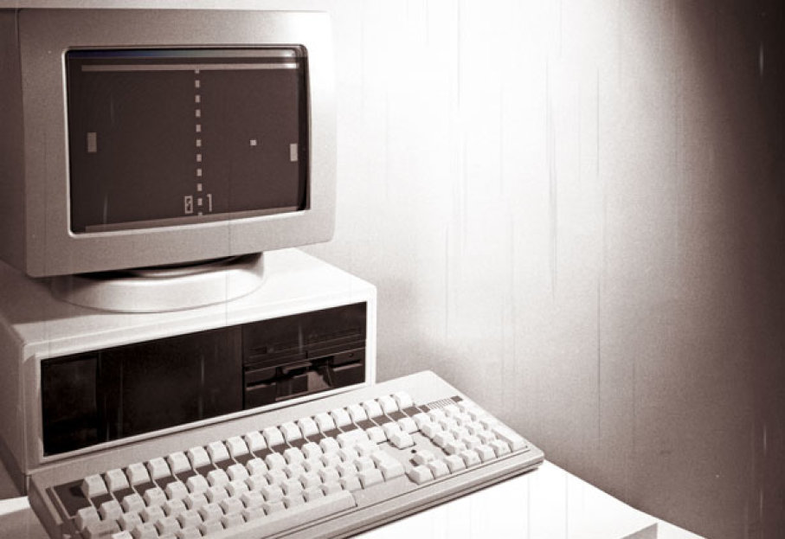
COMPUTER
Pioneering mathematicians Charles Babbage and Alan Turing changed the world with their strides towards developing the computer.

Slide 6
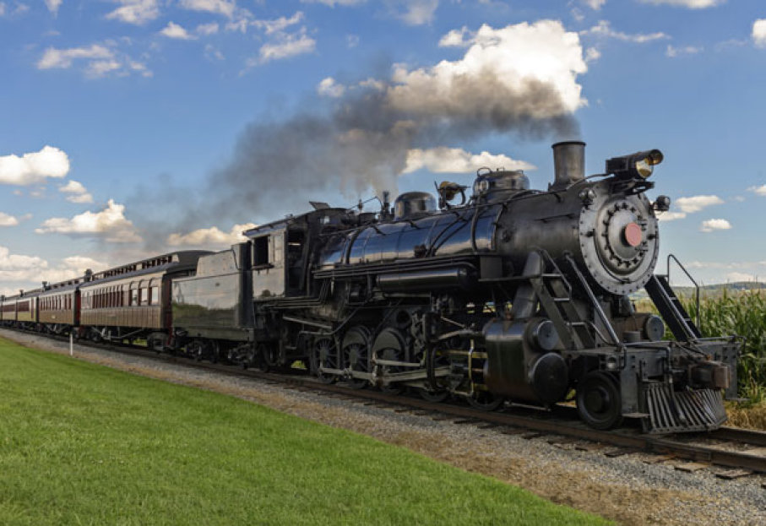
STEAM ENGINE
Developed by Thomas Newcomen during the 1712.

Slide 7
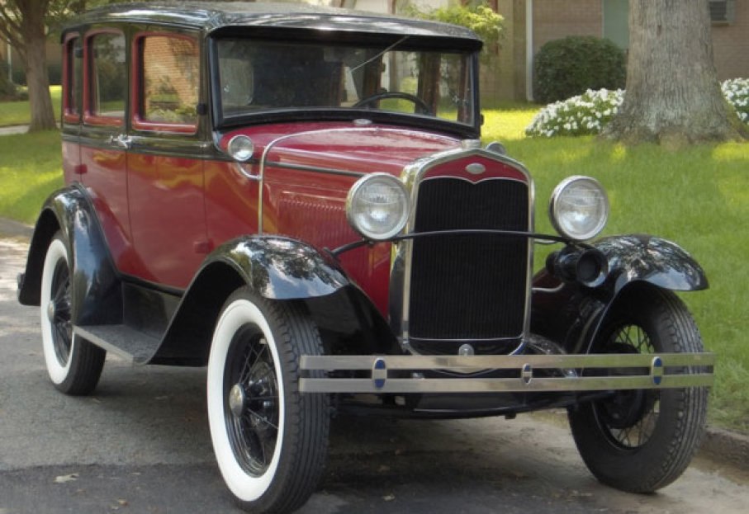
AUTOMOBILE
1885 was the year when Karl Benz’s produced the first automobile which moved on the power produced by its internal combustion engine.

Slide 8
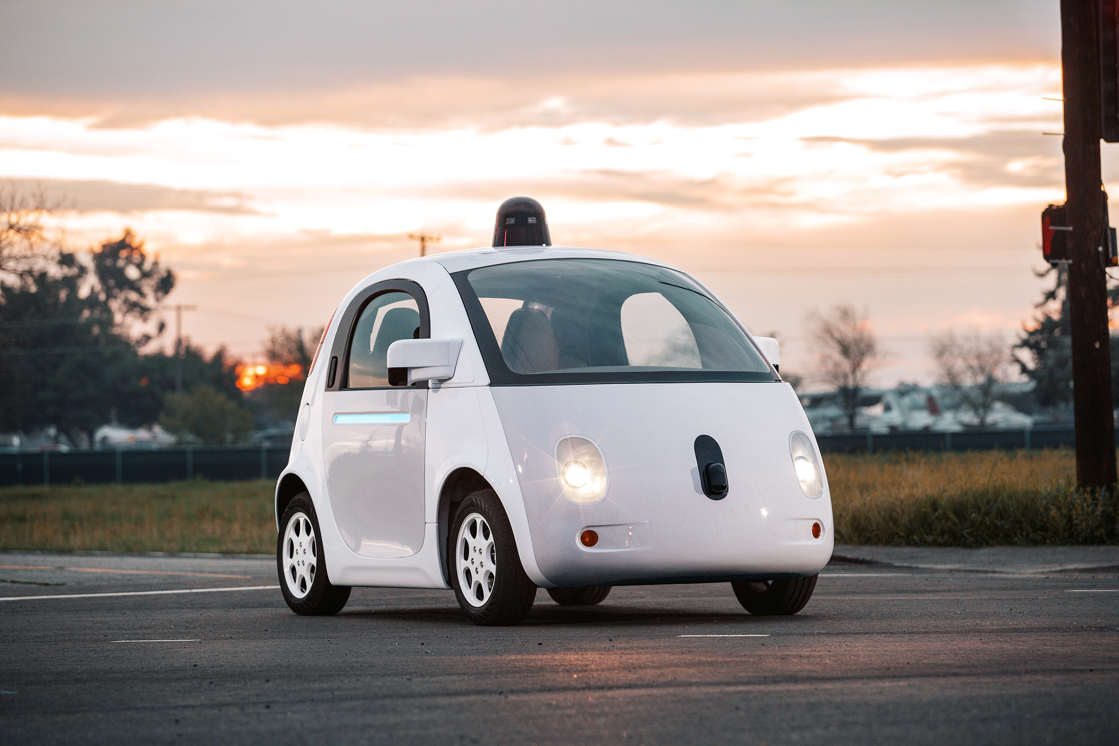
SELF DRIVING CAR

Slide 9
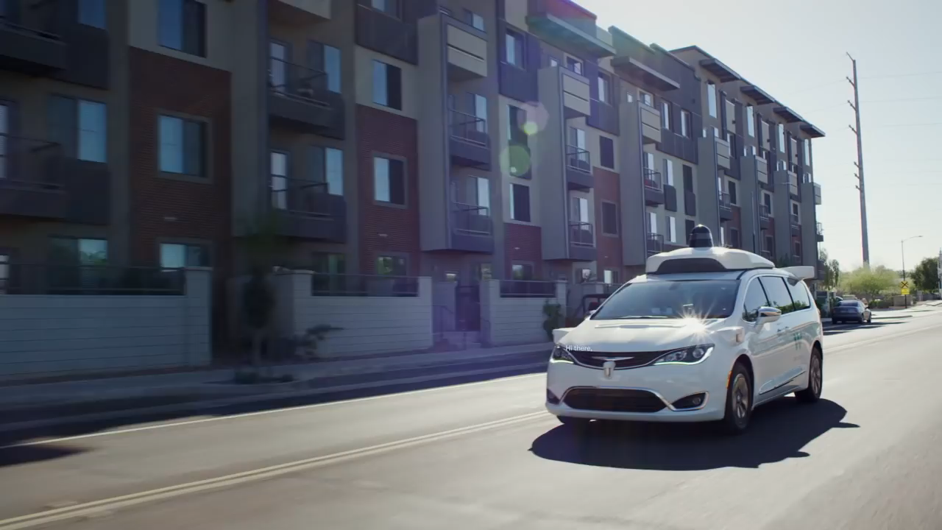

Slide 10

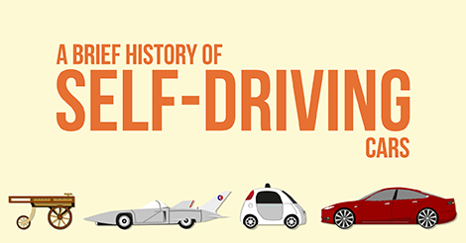

Slide 11
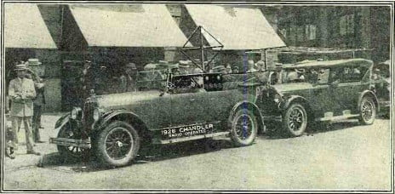
THE DRIVERLESS DREAM BEGINS
1925 - Francis Houdina demonstrates a radio-controlled car which can start its engine, shift gears, and sound its horn, “as if a phantom hand were at the wheel.”

Slide 12
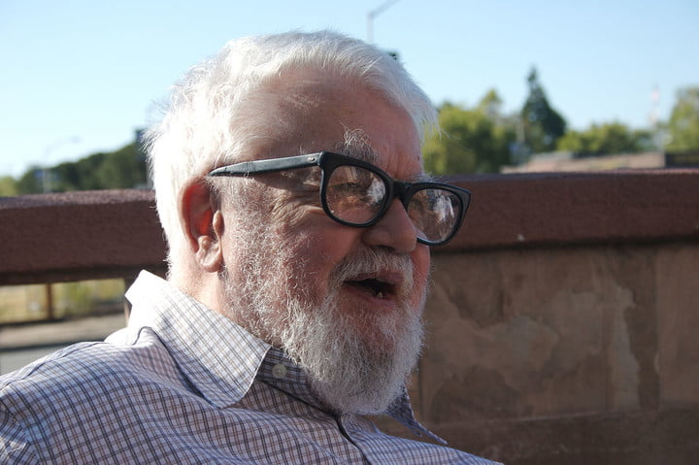
JOHN MCCARTHY’S ROBO-CHAUFFEUR
1969 - John McCarthy describes something similar to the modern autonomous vehicle in an essay titled “Computer-Controlled Cars.”

Slide 13
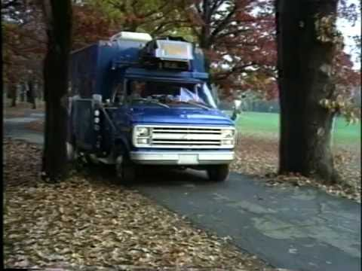
NO HANDS ACROSS AMERICA
1995 - Pomerleau and Todd Jochem take their Navlab self-driving car system on the road.

Slide 14
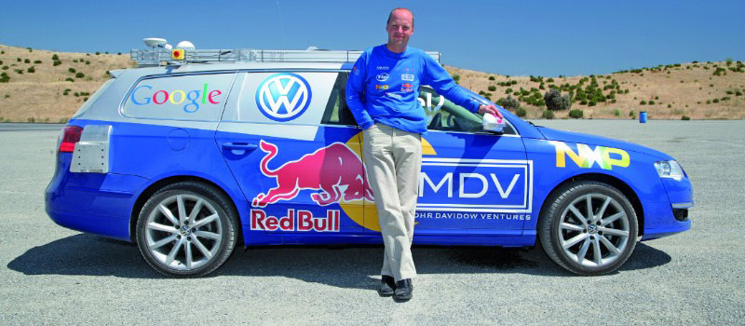
THE GRAND CHALLENGE IS TOO CHALLENGING
2002 - DARPA announces its Grand Challenge for building an autonomous vehicle able to navigate 142 miles through the Mojave Desert.

Slide 15
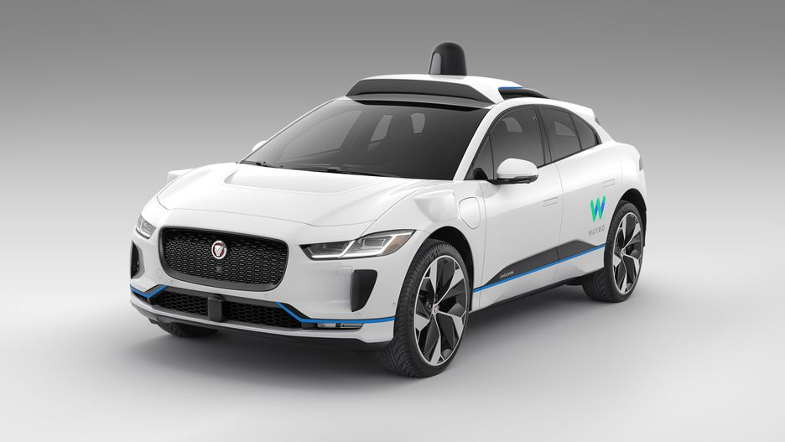
GOOGLE SEARCHES FOR AN ANSWER
2009 – GOOGLE begins developing its self-driving car project, now called WAYMO, in secret.

Slide 16
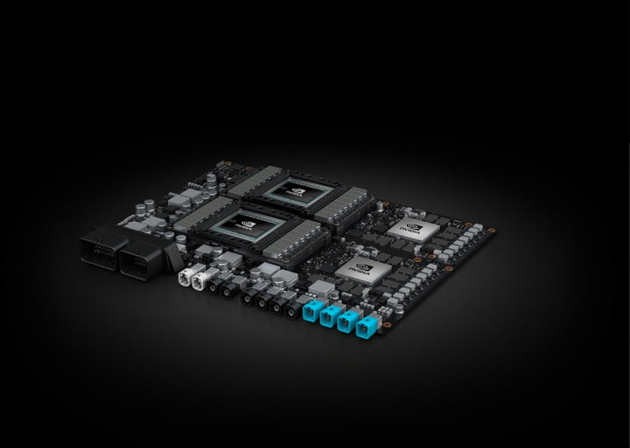
AI COMES TO SELF-DRIVING CARS
2018 - Nvidia unveiled a new self-driving car chip called Xavier that will incorporate artificial-intelligence capabilities.

Slide 17
Autonomy LEVELS
Level 0
Level 1
Level 2
Level 3
Level 4
Level 5
No automation
Limited driver assistance
Driver-assist systems
Autonomous mode in certain situations
autonomous mode most of the times
Fully autonomous

Slide 18
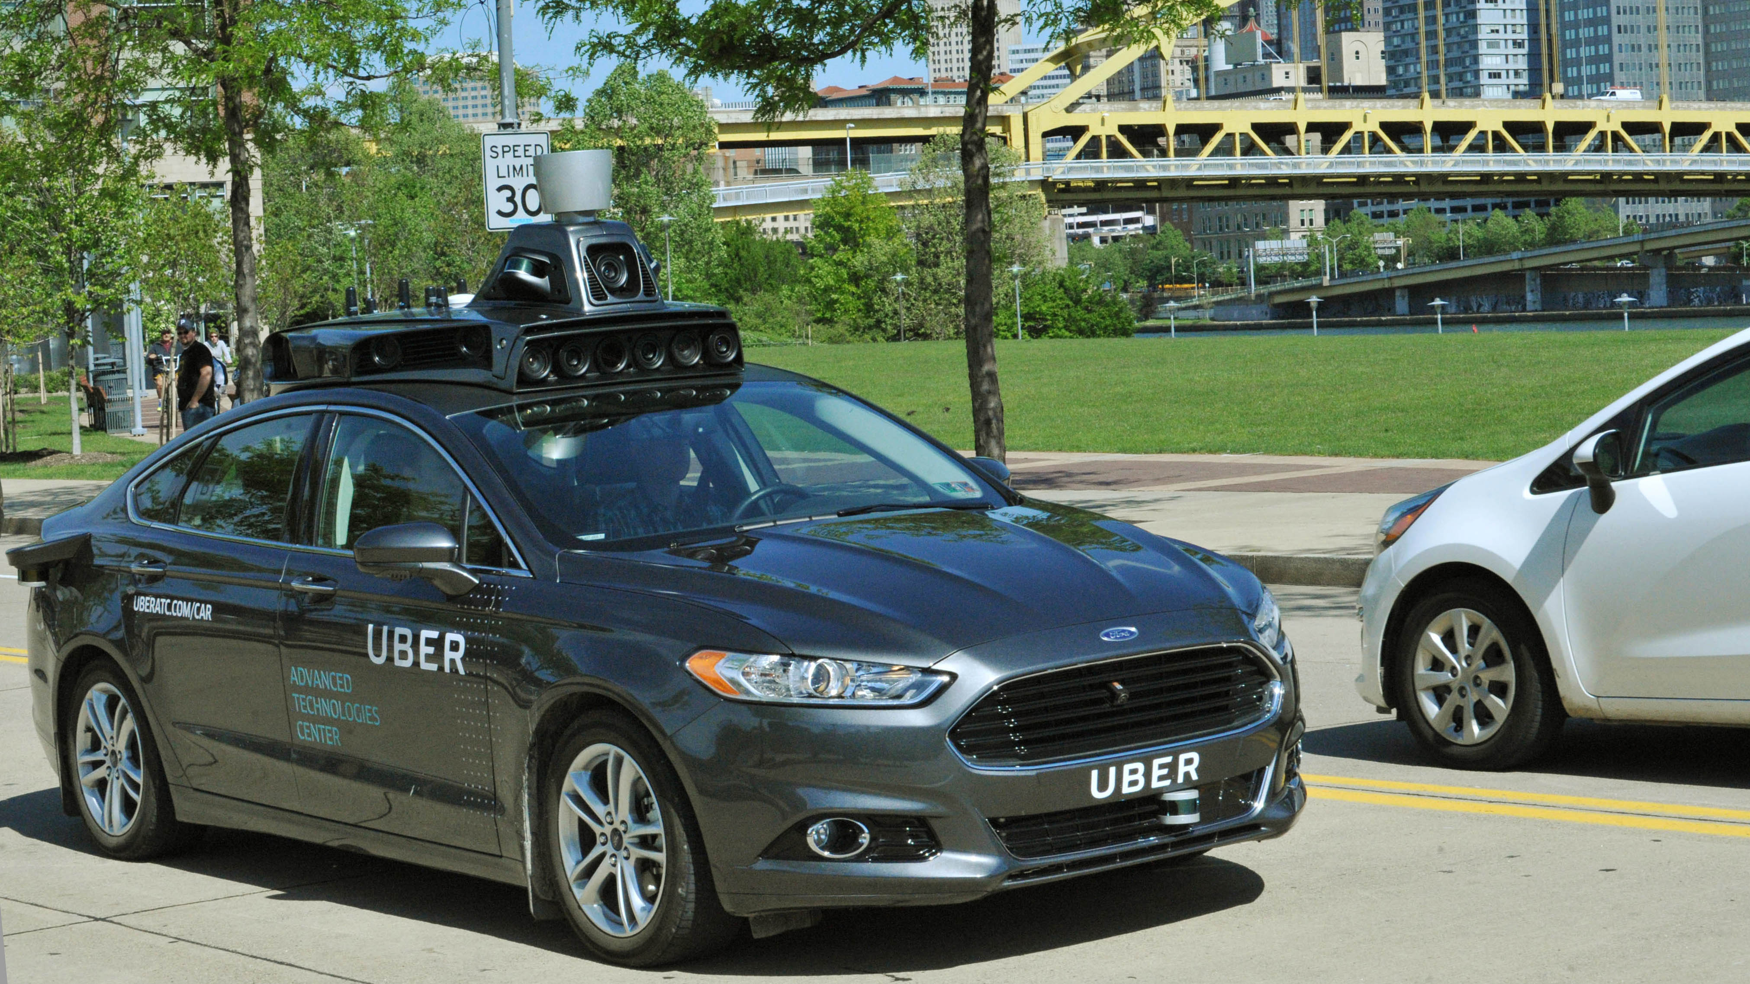
How a car drives itself

Slide 19
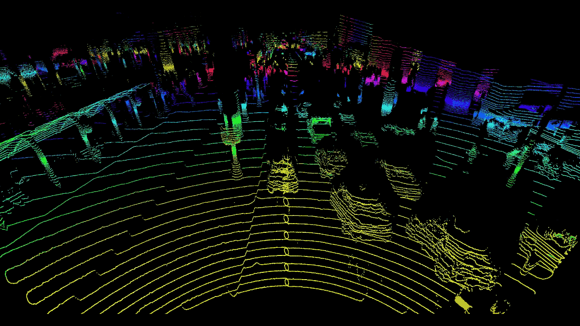
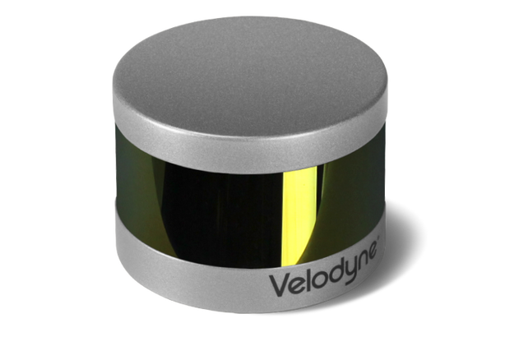
Lidar

Slide 20
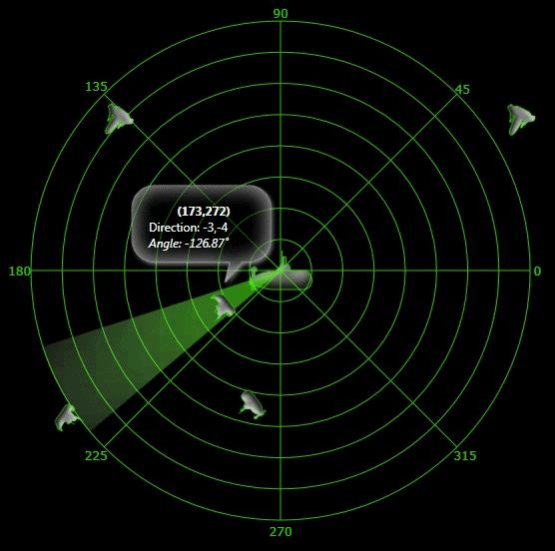

radar

Slide 21
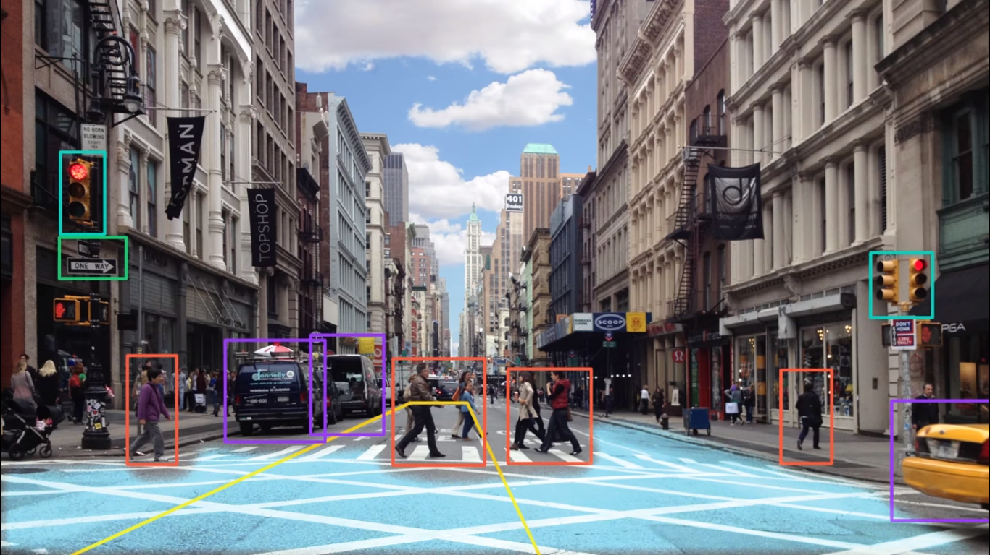
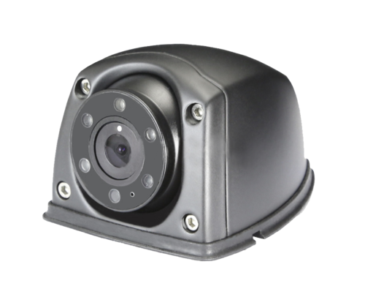
Camera

Slide 22
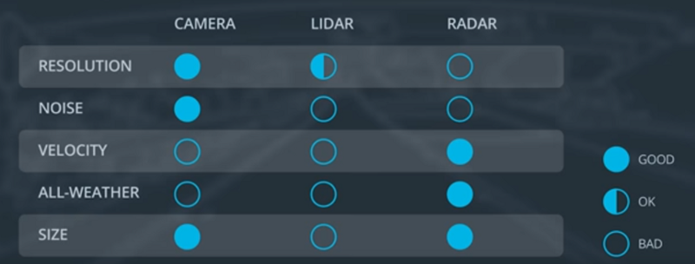
Sensor Comparison Chart

Slide 23
Autonomous Vehicle System Architecture
Sensors
Perception
Planning
Control
Camera
Radar
Lidar
GPS
Others
Detection
Route Planning
Behavior Planning
Localization
Trajectory Planning

Slide 24
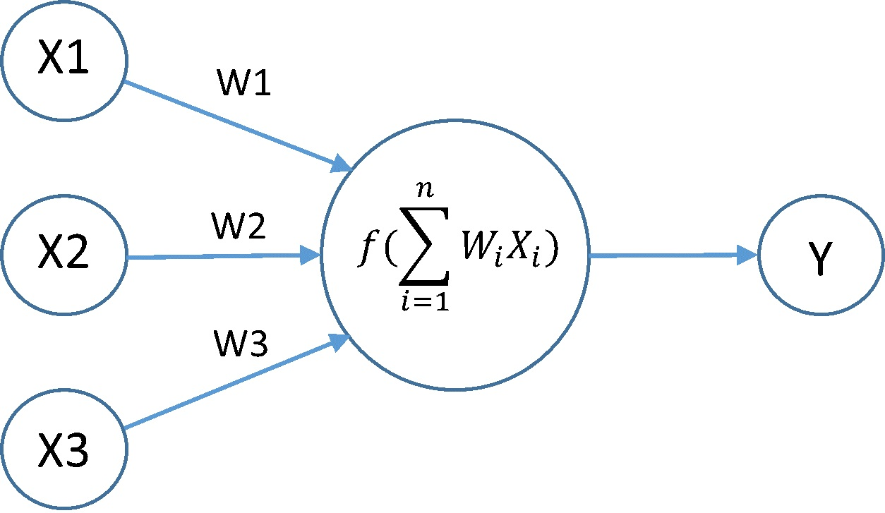
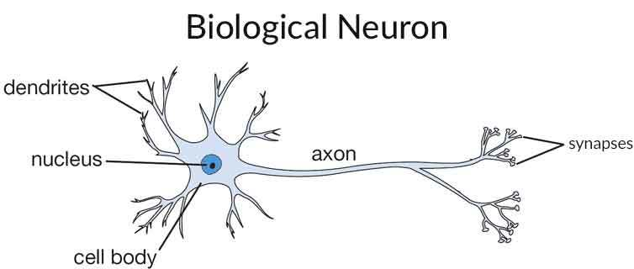
What does Artificial Intelligence (A.I.) mean ?
Artificial intelligence (AI) is an area of computer science that emphasizes the creation of intelligent machines that work and react like humans.

Slide 25
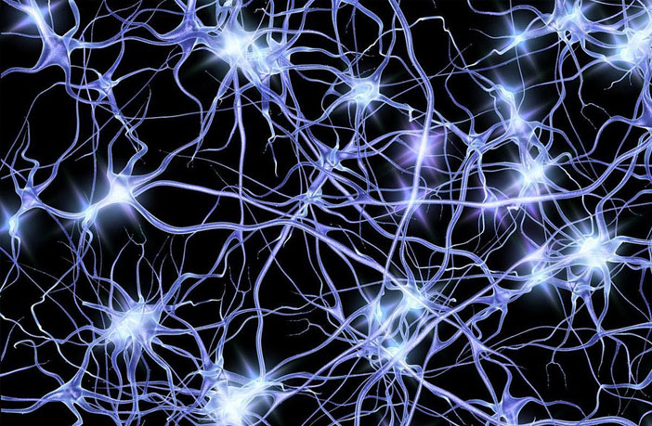
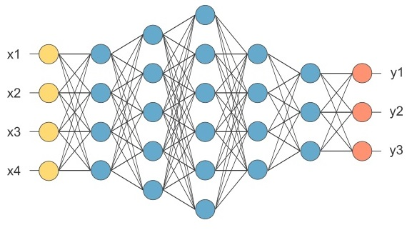
Neural Network
Neurons in Human Body
Neurons in Computer World

Slide 26
Pros
Cons
make our road safer
free up people’s time
improve mobility for everyone
expensive technology
computer malfunction could cause crashes
ethical problem

Slide 27
What Next ?

Slide 28
Hint
Mark my words: a combination airplane and motorcar is coming. You may smile, but it will come.
Henry Ford
- 1940

Slide 29
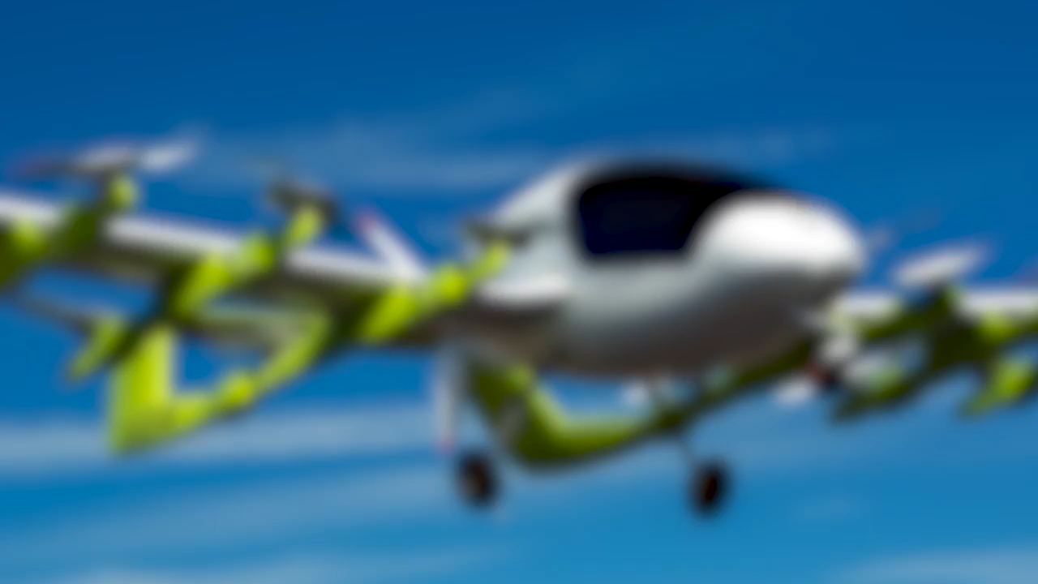

Slide 30
Any Questions ?

Slide 31
Thank-you

